Slide 1
Vidyavardhini’s College Of Engineering and Tecnology
Course Project: Machine Learning
Members:
5_Hardik Nikam
6_Dream Patel
10_Jay Prajapati

Slide 2
“Time Series Analysis on Sales using Random Forest”

Slide 3
Introduction
Time series forecasting is a critical task for large retail organizations like Walmart. Walmart is an American multinational wholesale retail corporation.
This project focuses on developing a Time Series Forecasting system tailored to Walmart, a major multinational retail corporation. Accurate forecasting is crucial for optimizing inventory, demand planning, and chain operations.
We employ diverse machine learning models with libraries like pandas, and sklearn to predict sales data over time. Walmart's vast dataset, spanning multiple stores, product categories, and regions, presents data management challenges.

Slide 4
Problem Statement
Walmart's dataset is extensive, comprising sales data from thousands of stores, various product categories, and diverse regions. Managing and processing this data efficiently is a challenge.
Ensuring data quality and consistency is vital for accurate forecasting. Missing data, outliers, and data anomalies can significantly impact model performance.

Slide 5
Proposed System
This project employs diverse machine learning models utilizing libraries like pandas, and sklearn, to forecast time series sales data. It underscores the critical role of analyzing and predicting these data points for informed decision-making.
The core aim of this project is to create a robust Time Series Forecasting system for Walmart, employing a range of Machine Learning models, including Linear Regression, Random Forest, K Neighbors, XGBoost and compare them.

Slide 6
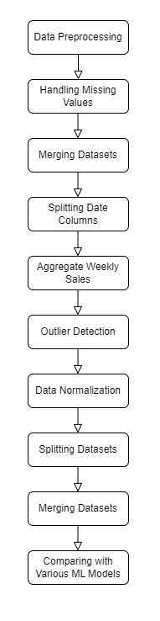
Implementation

Slide 7
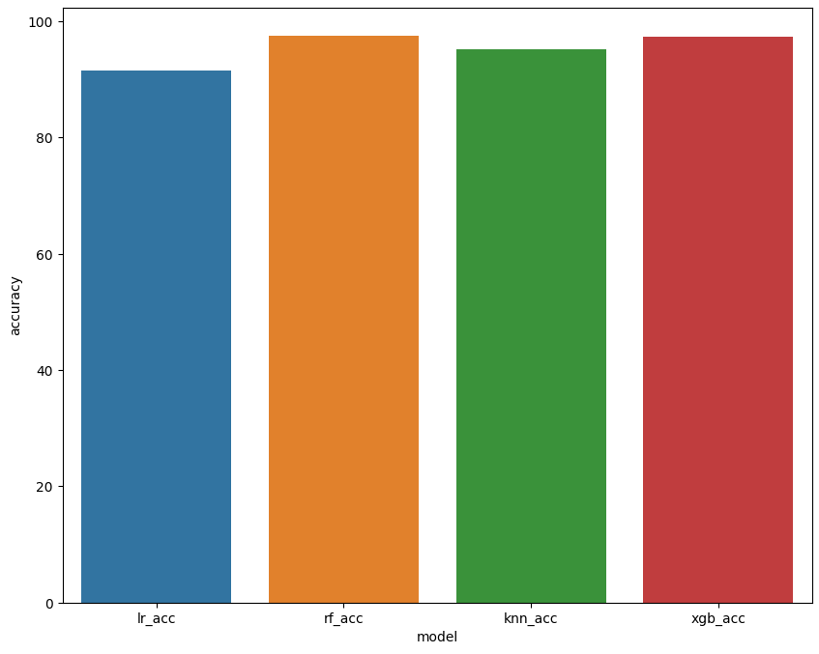
Result

Slide 8
Conclusion
This machine learning project employing Random Forest for time series analysis on Walmart's sales represents a significant step toward enhancing sales forecasting accuracy. It addresses the limitations of traditional methods in prediction and can capture more complex sales patterns. However, the project's success hinges on meticulous data preprocessing, feature selection, and model optimization to maximize Random Forest's potential.

Slide 9
Thank You

